Slide 1


Workforce Readiness Outreach Specialist
Empowering Students Through Career Development and
Testimonial from Brownsville ISD, CTE Director Mr. Adrian Dorsett
Anna Munivez, Workforce Solutions Cameron, February 27,2025

Slide 2
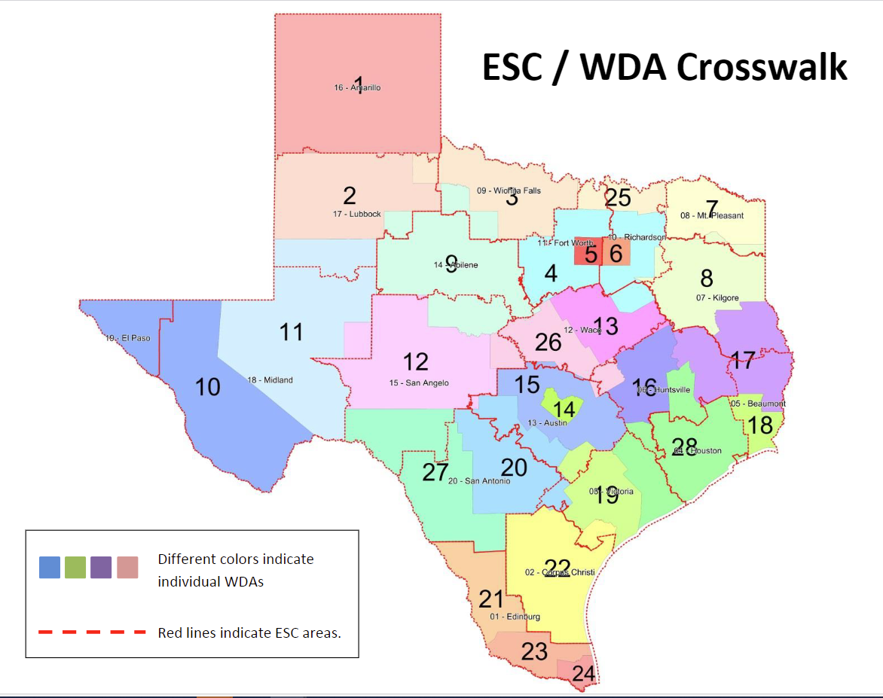
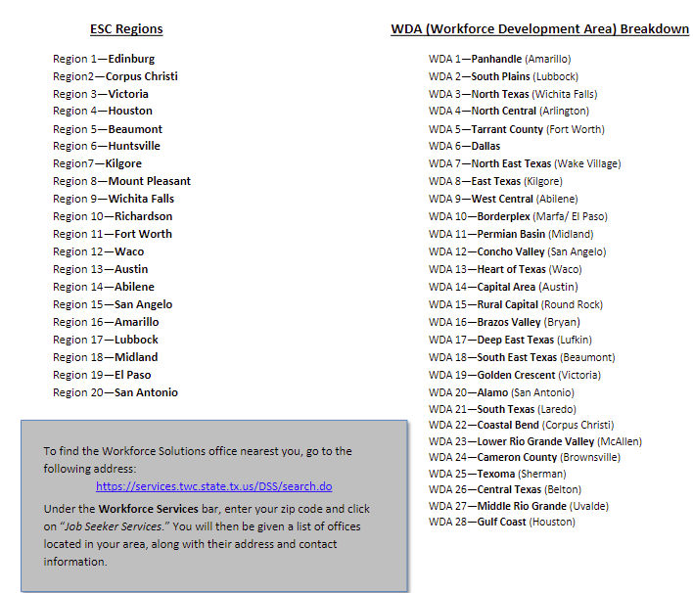
There are 28 Workforce Boards in the State of Texas.

Slide 3
The Workforce Readiness Outreach Specialists Role:
A Workforce Readiness Outreach Specialist is responsible for educating, engaging, and empowering students to explore career opportunities and develop the skills needed to succeed in the workforce of the future.
This role serves as a bridge between education, community resources, and industry partners, ensuring that students have access to meaningful career pathways, workforce development programs, and supportive services.
The specialist designs and delivers workforce readiness programming—including workshops, presentations, and hands‑on activities—that build essential employability skills such as communication, professionalism, digital literacy, teamwork, and problem‑solving.
Through individualized guidance and group instruction, they help students identify their strengths, set career goals, and connect with training, internships, apprenticeships, and employment opportunities.

Slide 4

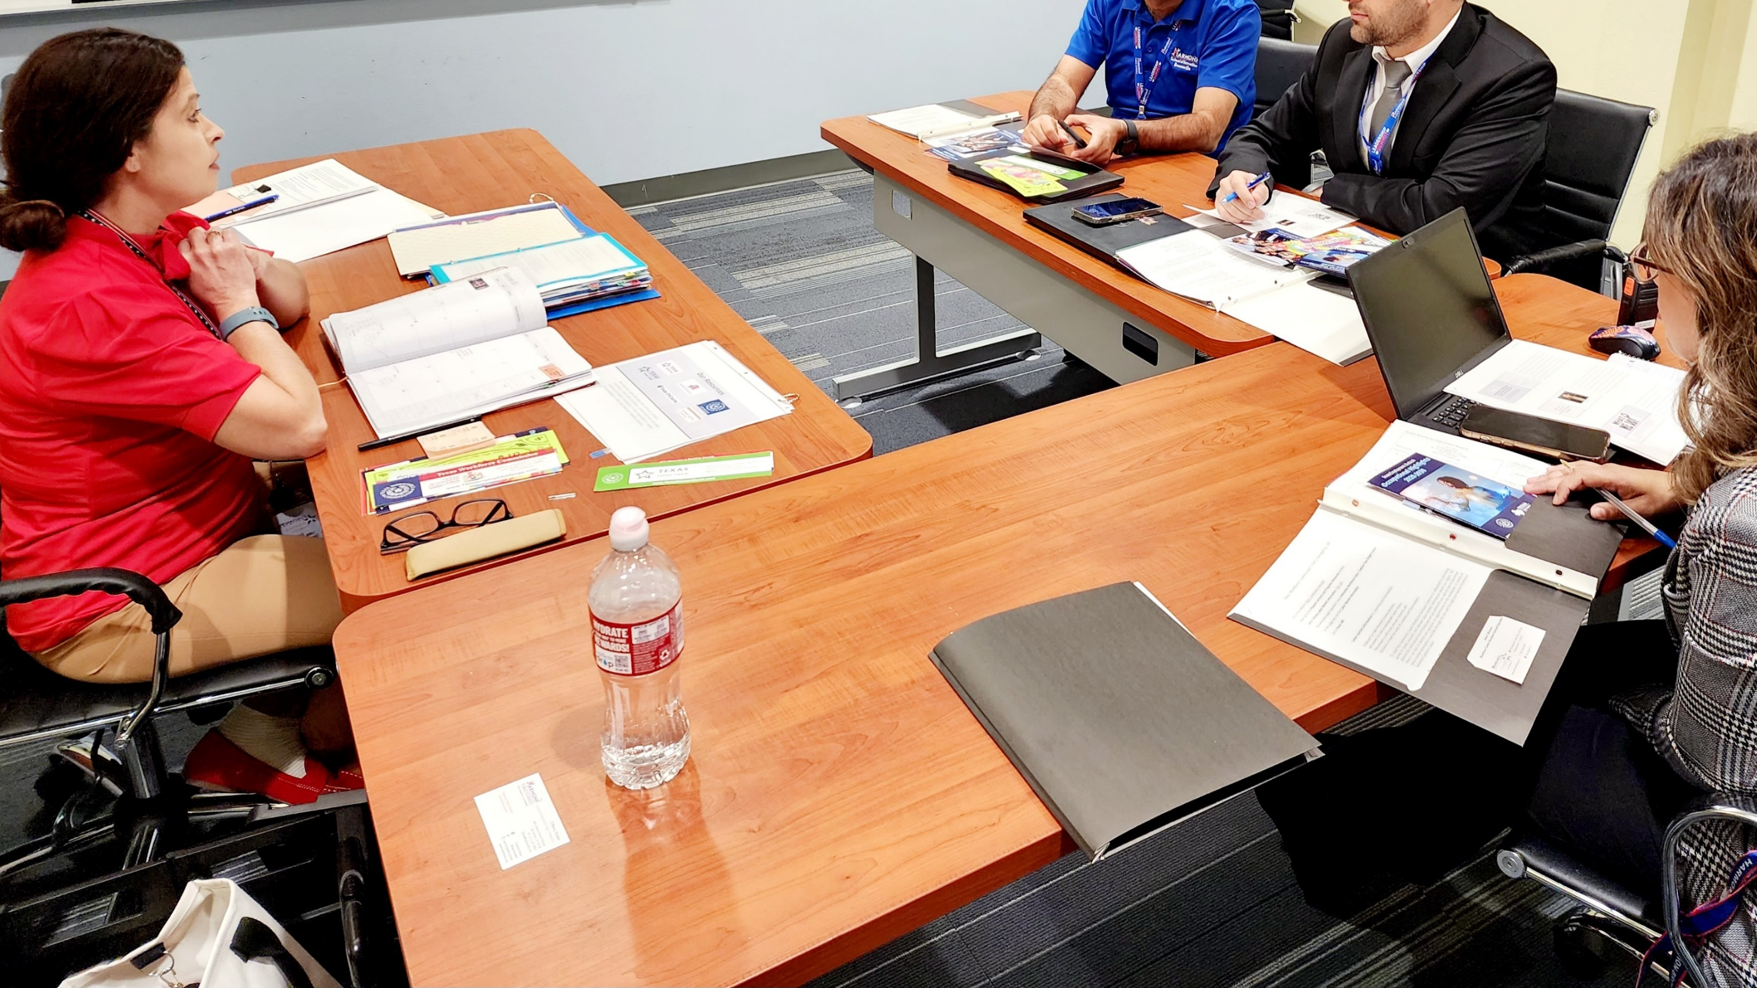



The Importance of the role:
They bridge the gap between students and opportunity.
They strengthen the local economy by preparing future workers.
They build partnerships that support workforce systems.
They help students overcome real barriers to success.
They prepare students for the future of work and creates generational impact.

Slide 5
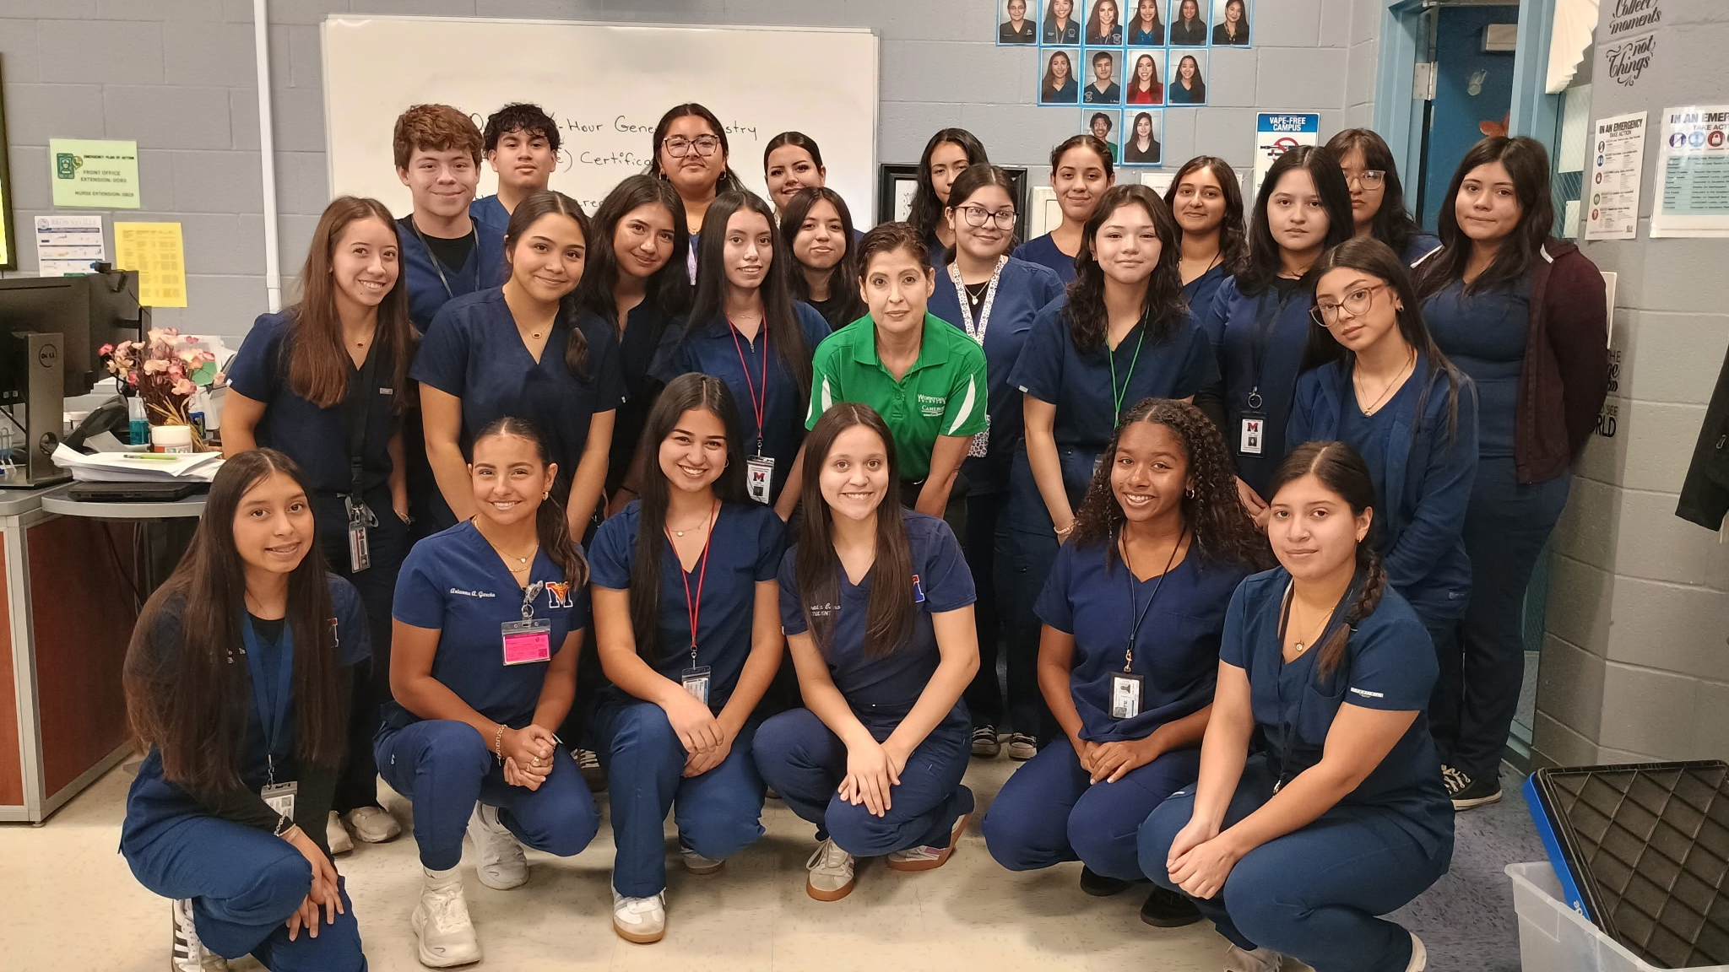
Workforce Readiness Outreach Specialist serves:
Students
Parents/ Guardians
CTE Directors
Counselors
Teachers
School Administrators
Community Partners
Employers

Slide 6
What is the Workforce Readiness
Program?

Slide 7
A program designed to equip students with comprehensive information on, regional labor‑market data, career exploration resources, postsecondary education options and workforce services, enabling them to make well‑informed career decisions upon graduation.

Slide 8
We tailor workshops to meet the needs of each audience.
We engage students by conducting school presentations that include activities.

Slide 9
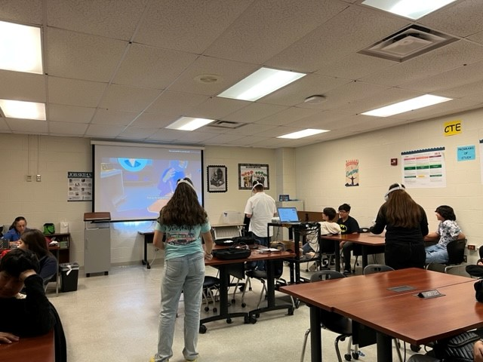
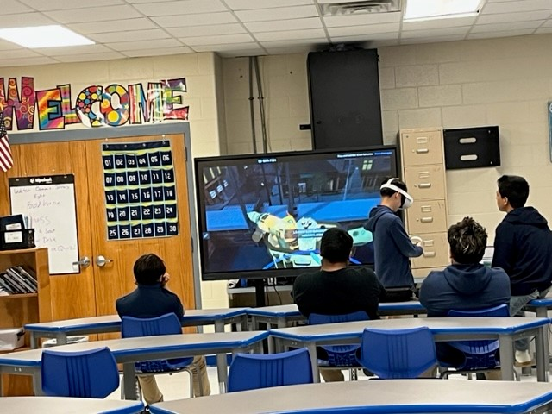
Career Pathway Exploration through Virtual Reality Simulators

Slide 10




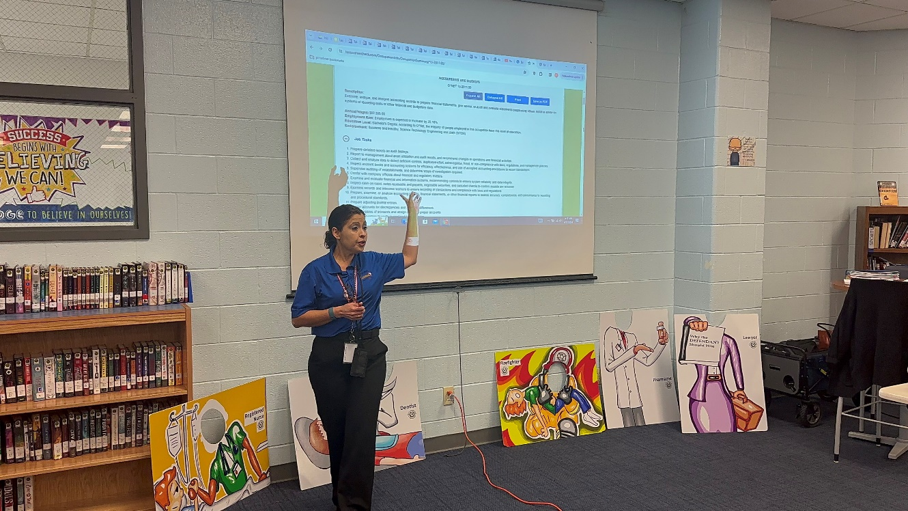
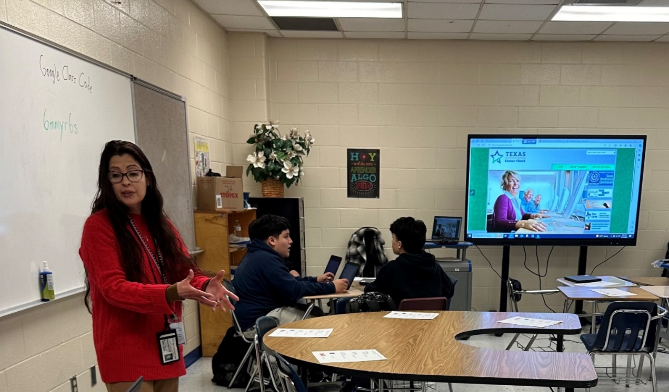




Career Pathway Exploration by utilizing website resources.

Slide 11
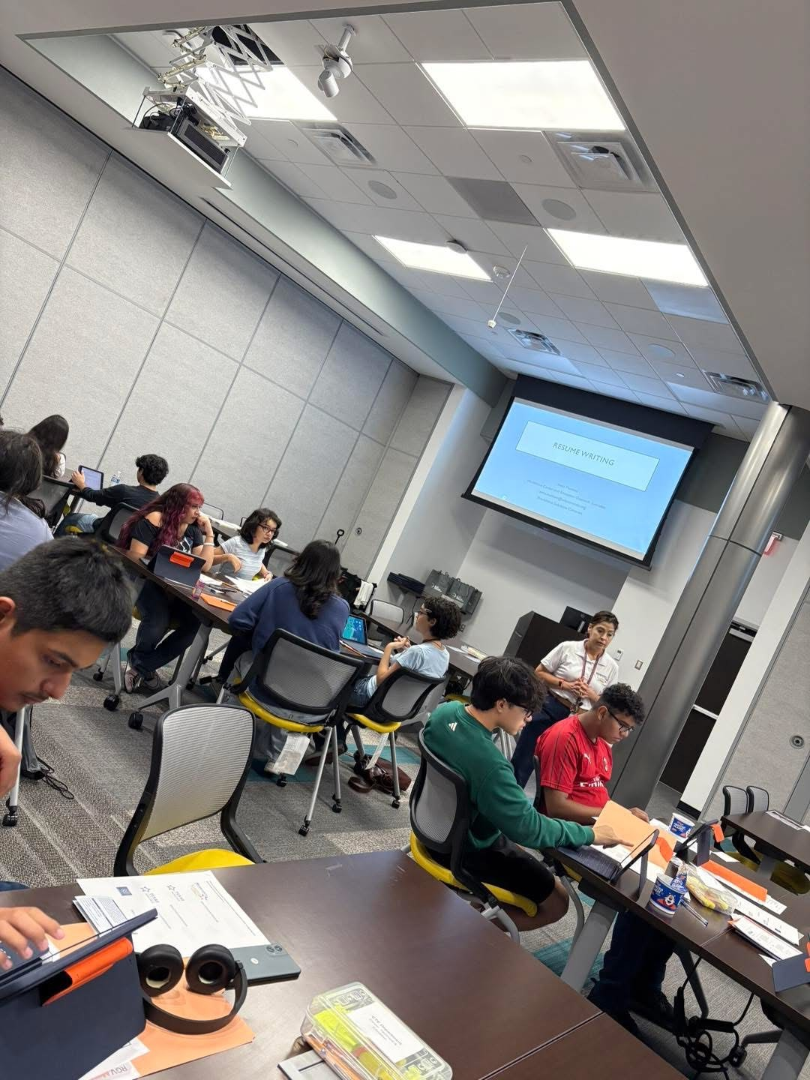
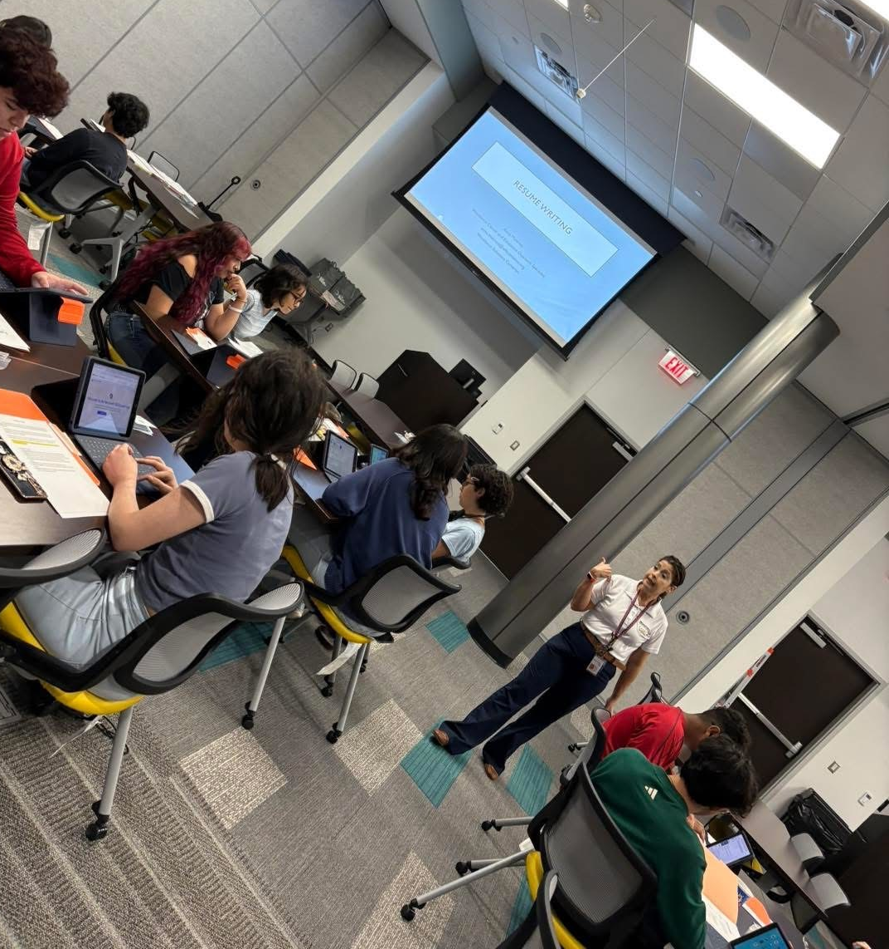

Preparing the students with Resume writing skills.

Slide 12
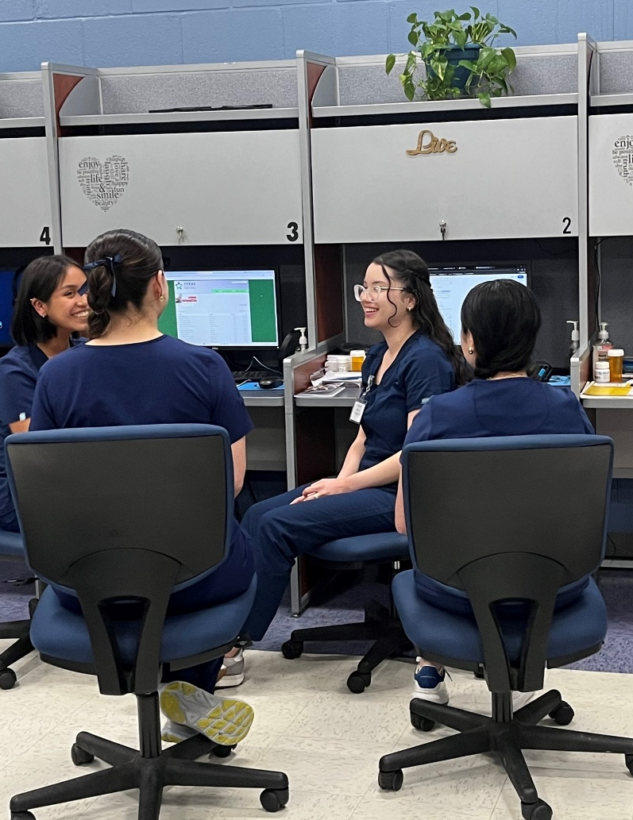
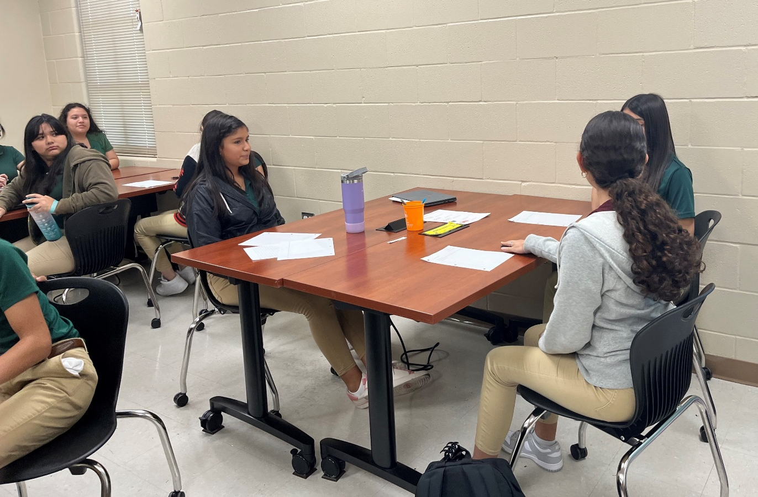

Preparing the students with Soft Skills.

Slide 13

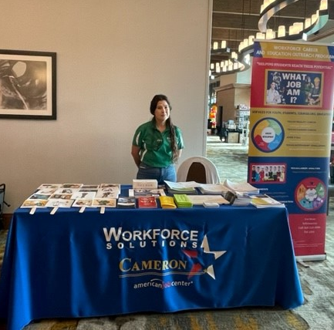
Provide informational booths with a variety of resources for the students in College & Career Fairs.

Slide 14
Impact and Outcomes

Slide 15

Any questions?

Slide 16
Are you interested?
Workforce Readiness Outreach Specialist Services or for additional information, contact:
Workforce Solutions Cameron
Workforce Readiness
Outreach Specialist
Anna Munivez
anna.munivez@wfscameron.org
956-548-6700 Ext: 4501 Office
Equal opportunity employer/program. Auxiliary aids and services are available upon request to individuals with disabilities.
Relay: 1-800-735-2989 (TTY) /711 (Voice)

